Slide 1
Paper ID: 354 Interpretable Retinal Disease Classification from OCT Images Using Deep Neural Network and Explainable AI
International Conference on Electronics, Communications and Information Technology ICECIT 2021

Slide 2
Presented By:-
Farzad Ahmed

Slide 3
Introduction
Eye Diseases or ocular dysfunctions are very common
Chorodial Neovascularization (CNV), Diabetic Macular Edema (DME), accumulation of Drusen
Estimation of affected people to grow triple by 2050
Automated approach necessary
Proposed a deep learning method
Detect CNV, DME and accumulation of Drusen
Attempted to explain misclassification through XAI framework

Slide 4
Literature Review
Shah et al. [1] tried to detect Stargard disease from OCT images using pre trained CNN model (VGG19) to distinguish normal, mild and severe STGD which achieved very high accuracy but was unable to distinguish milder and severe STGD.
Li et al. [2] also worked tried to classify three different Retinal Diseases, CNV, DME and Drusen from OCT images using an ensemble of four classification model based on ResNet50 which achieved an accuracy of 96%.
Lamaitre et al. [3] extracted Local Binary Patterns (LBP) features from OCT images to detect DME patients which achieved 81.2% Sensitivity and 93.7% Specificity.

Slide 5
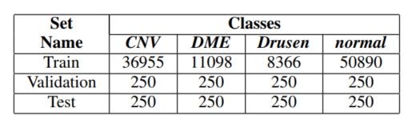
Dataset Details

Slide 6
Models
Inception V3
ResNet50
EfficientNetB0

Slide 7
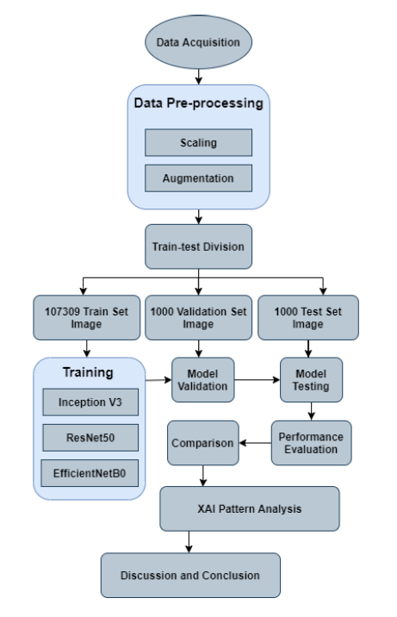
Proposed model

Slide 8
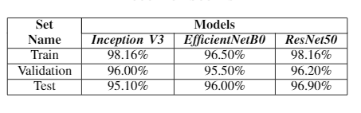
Result and Analysis
Highest accuracy is achieved by ResNet (96.9%)
Marginally higher that the result proposed in the base paper (96.6%)
Achieved with only 10 epochs

Slide 9
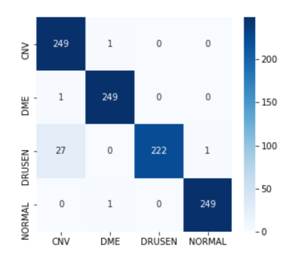
Confusion Matrix
Very good results on CNV DME and Normal images
Poor results on DRUSEN effected images
Lots of DRUSEN images are misclassified as CNV image

Slide 10
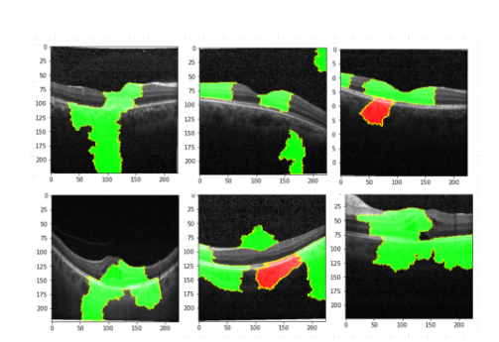
XAI on Correct Classifications
Green color pixels responded for the correct labels
Red colored pixels responded for the incorrect labels

Slide 11
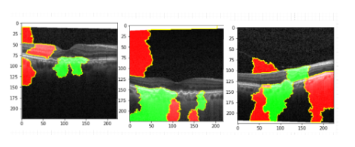
XAI on Incorrect Classifications
Some highlights on background pixels
A definite reason for errors

Slide 12
Proposed Ideas for Future Improvement
Weighting the classes according to their distribution
Background noise removal
Attention based model focused on the choroid region

Slide 13
THANK YOU

